Slide 1
Machine Learning
Machine Learning Introduction to Machine Learning by Kumar Anurupam is licensed under a Creative Commons Attribution-4.0 International License.
Dimensionality Reduction – Feature Selection and Introduction to PCA
CS 3104 Fall 2019
Lecture Slides by Kumar Anurupam

Slide 2
Learning Objectives
After completion of today’s session you will be able to:
Define dimensionality reduction
Explain the concept of feature selection
Discuss the importance of PCA

Slide 3
Dimensionality Reduction
In machine learning classification problems, there are often too many factors on the basis of which the final classification is done. These factors are basically variables called features.
The higher the number of features, the harder it gets to visualize the training set and then work on it. Sometimes, most of these features are correlated, and hence redundant.
This is where dimensionality reduction algorithms come into play.
Dimensionality reduction is the process of reducing the number of random variables under consideration, by obtaining a set of principal variables.

Slide 4
Components of Dimensionality Reduction
There are two components of dimensionality reduction:
Feature selection: In this, we try to find a subset of the original set of variables, or features, to get a smaller subset which can be used to model the problem. It usually involves three ways:
Filter (Uses the concept of information gain)
Wrapper (e.g. search guided by accuracy)
Embedded (features are selected to add or be removed while building the model based on the prediction errors. e.g. regularization)
Feature extraction: This reduces the data in a high dimensional space to a lower dimension space, i.e. a space with lesser no. of dimensions.

Slide 5
Filters
Methods:
Criterion: Measure feature/feature subset “relevance”
Search: Usually order features (individual feature ranking or nested subsets of features). Each independent variable is evaluated for its predictive capabilities
Assessment: Use statistical tests
Are (relatively) robust against overfitting
May fail to select the most “useful” features
Results:

Slide 6
Wrappers
Methods:
Criterion: Measure feature subset “usefulness”
Search: Search the space of all feature subsets
Assessment: Use cross-validation
Can in principle find the most “useful” features, but
Are prone to overfitting
Results:

Slide 7
Embedded Methods
Methods:
Criterion: Measure feature subset “usefulness”
Search: Search guided by the learning process
Assessment: Use cross-validation
Similar to wrappers, but
Less computationally expensive
Less prone to overfitting
Results:

Slide 8
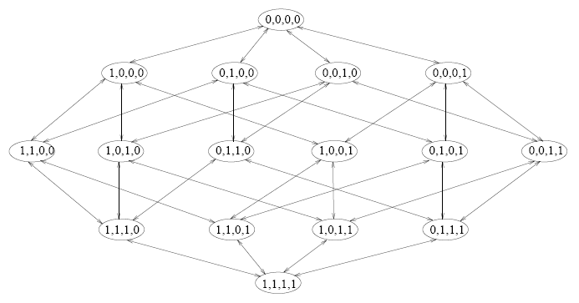
Forward Selection (wrapper)
Start
n
n-1
n-2
1
…
Also referred to as SFS: Sequential Forward Selection

Slide 9
Forward Selection (embedded)
Start
n
n-1
n-2
1
…
Guided search: we do not consider alternative paths.

Slide 10
Backward Elimination (wrapper)
Also referred to as SBS: Sequential Backward Selection
1
n-2
n-1
n
…
Start

Slide 11
Backward Elimination (embedded)
1
n-2
n-1
n
…
Start

Slide 12
Methods of Dimensionality reduction
The various methods used for dimensionality reduction include:
Principal Component Analysis (PCA)
Linear Discriminant Analysis (LDA)
Generalized Discriminant Analysis (GDA)
Dimensionality reduction may be both linear or non-linear, depending upon the method used.

Slide 13
PCA
This method was introduced by Karl Pearson.
Principal component analysis (PCA) is a statistical procedure that uses an orthogonal transformation to convert a set of observations of possibly correlated variables (entities each of which takes on various numerical values) into a set of values of linearly uncorrelated variables called principal components.
It works on a condition that while the data in a higher dimensional space is mapped to data in a lower dimension space, the variance of the data in the lower dimensional space should be maximum.

Slide 14
Explanation

Slide 15
Uses of PCA
Face Recognition
Image Compression
Gene Expression

Slide 16
References
[1] https://www.geeksforgeeks.org/dimensionality-reduction/
[2] Feature Extraction, Foundations and Applications, I. Guyon et al, Eds. Springer, 2006.
[3] https://en.wikipedia.org/wiki/Principal_component_analysis

Slide 17
Thanks

